Slide 1


0-1
CSC 572 DATA SCIENCE
ESSENTIALS
FINAL PROJECT
Mohammed Ali Touseef
01

Slide 2

PROJECT
Predicting Full time result
of a game in the English premier league
0-2
02

Slide 3
Outline
Objective
Background Information
Feature selection
Prediction of Chances of winning
Analysis of the Project

Slide 4
Objective : Purpose : The Purpose of the project is to create a model that predicts the full-time result of a game in the English premier league.
Approach :
Understanding the role of teams, data and statistics of professional soccer teams.
Identifying features selection.
Analysis of the project:
Implementing the model to find the overall quality of model and accuracy.
Outcome of the model:
To predict the result of a game.
Resources and Applications used:
Random Forest model.
Data set accessed from http://www.football-data.co.uk/
Lectures provided by Mike bernico and you-tube.
Anaconda
Python 2.7

Slide 5
Features Selection
Overview:
Selecting the features that are best suitable to predict the outcome of a games result.
A data scientist will normally include the features that can help the model to predict the outcome and removing the features that have no impact on the data (or) the model.
In order to make a model more precise, perfect and accurate one would like to use as much information that a league provides.
The Most important information of the league such as teams Home goals, Away goals, Home Team corners, Away Team corners, Home Team shots and Away Team shots are critical to predict the outcome of a game.

Slide 6
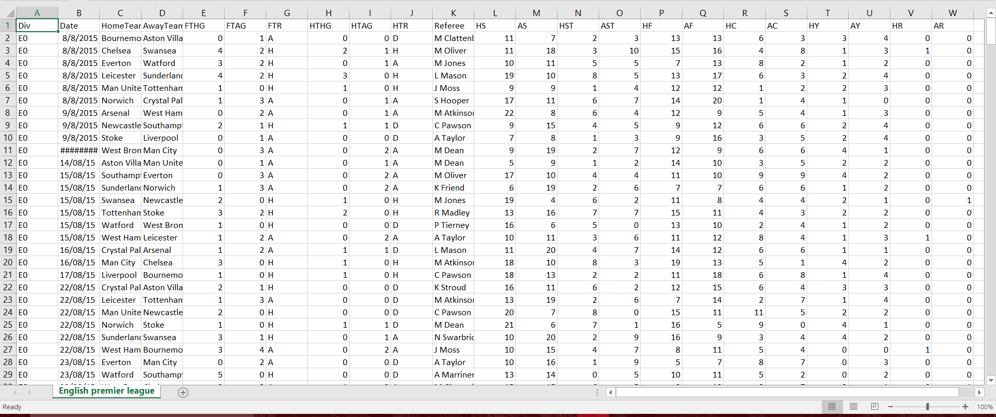
Information about Key Features:
Statistics of English premier league (2015)

Slide 7
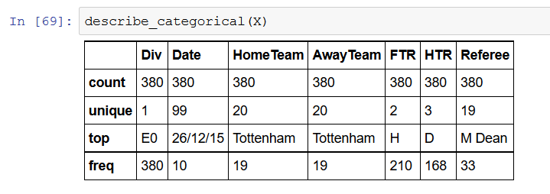
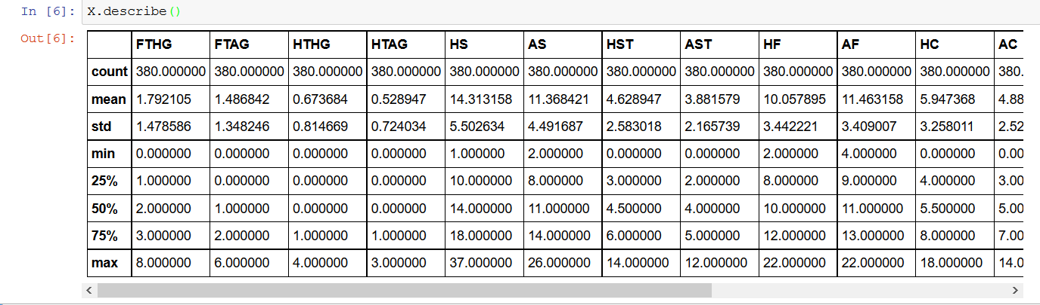
Categorical variables:
Continuous variables:

Slide 8
Key features of Dataset:
Key to results data:
1..Div = League Division
2..Date = Match Date (dd/mm/yy)
3..HomeTeam = Home Team
4.AwayTeam = Away Team
5.FTHG = Full Time Home Team Goals
6.FTAG = Full Time Away Team Goals
7.FTR = Full Time Result (H=Home Win, D=Draw, A=Away Win)
8.HTHG = Half Time Home Team Goals
9.HTAG = Half Time Away Team Goals
10.HTR = Half Time Result (H=Home Win, D=Draw, A=Away Win)
11.Referee = Match Referee
12.HS = Home Team Shots
13.AS = Away Team Shots
14.HST = Home Team Shots on Target
15.AST = Away Team Shots on Target
16.HC = Home Team Corners
17.AC = Away Team Corners
18.HF = Home Team Fouls Committed
19.AF = Away Team Fouls Committed
20.HO = Home Team Offsides
21.AO = Away Team Offsides
22.HY = Home Team Yellow Cards
23.AY = Away Team Yellow Cards
24.HR = Home Team Red Cards
25.AR = Away Team Red Cards

Slide 9

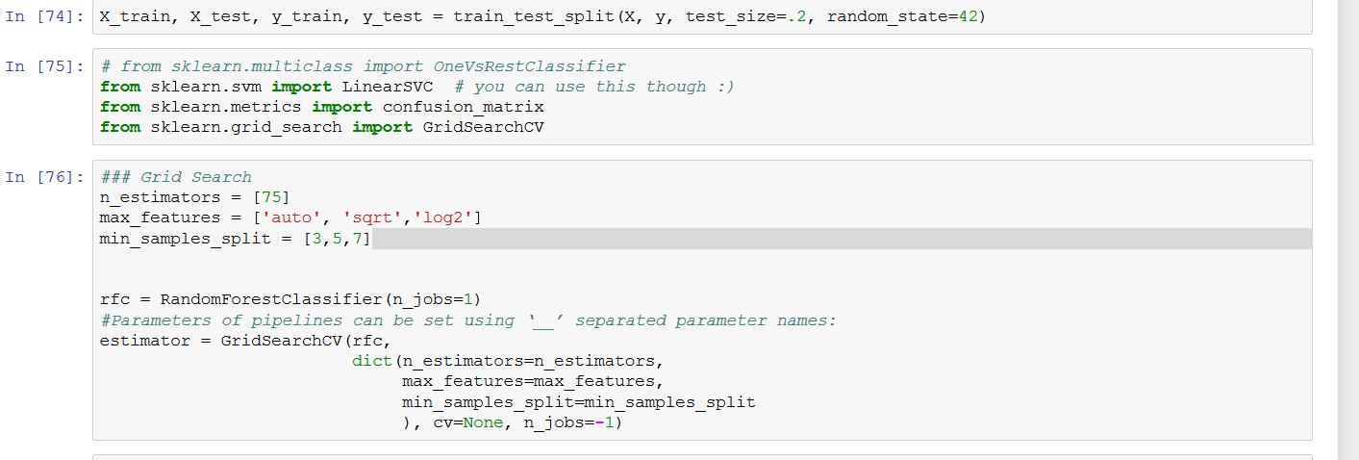
Dropping of unwanted features:
Dropping unwanted features like Division , Date of game played, Referee and Half Time result which has no impact on the data
Prediction of result using Random forest: model

Slide 10
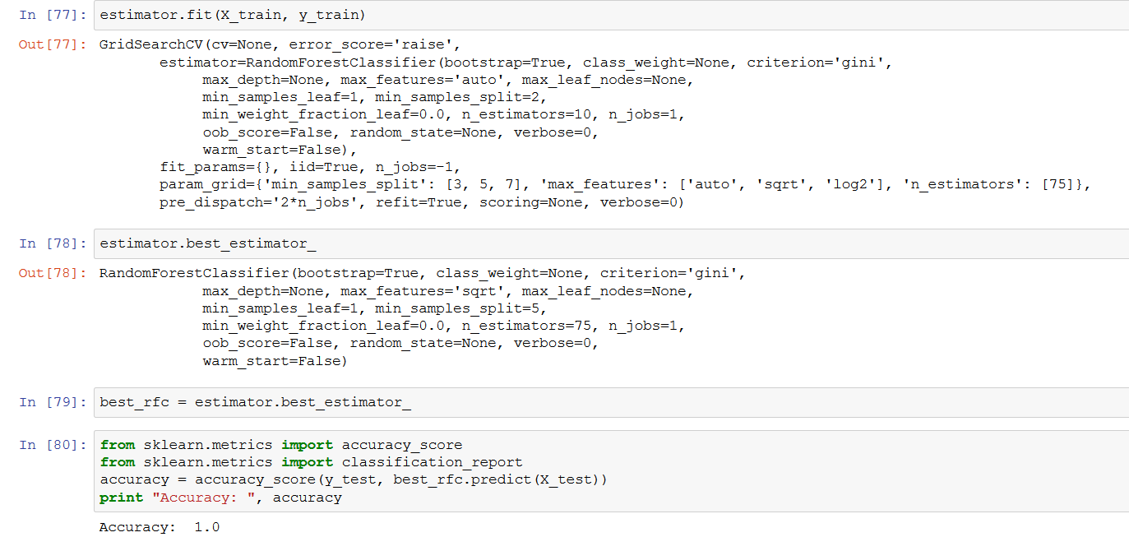

Slide 11
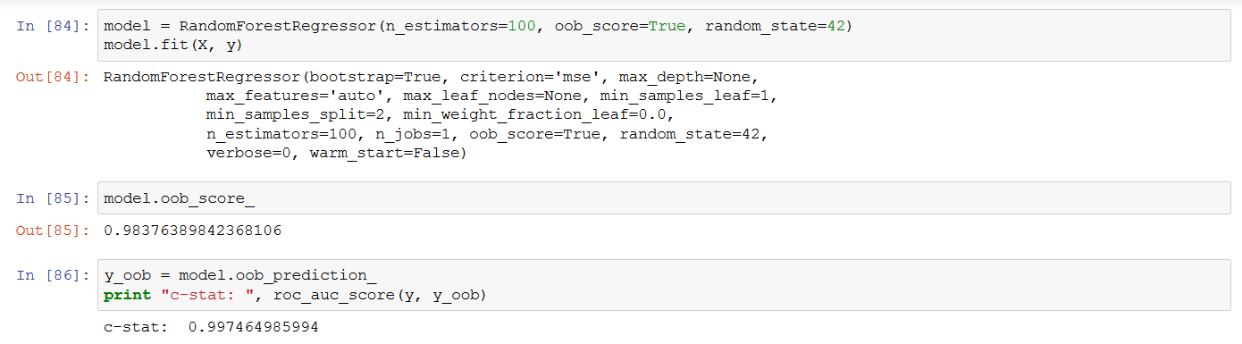

Slide 12
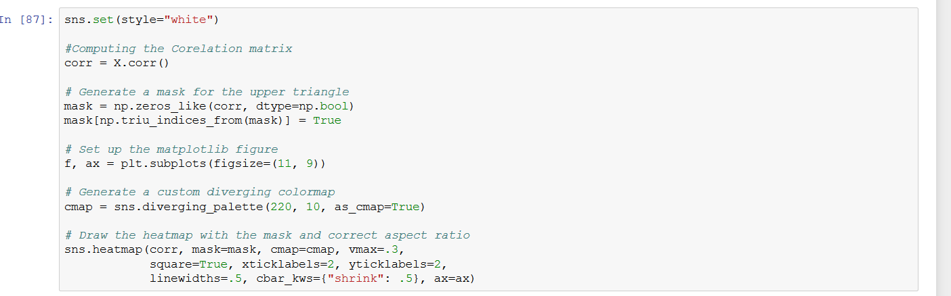
Plotting the Graph:

Slide 13
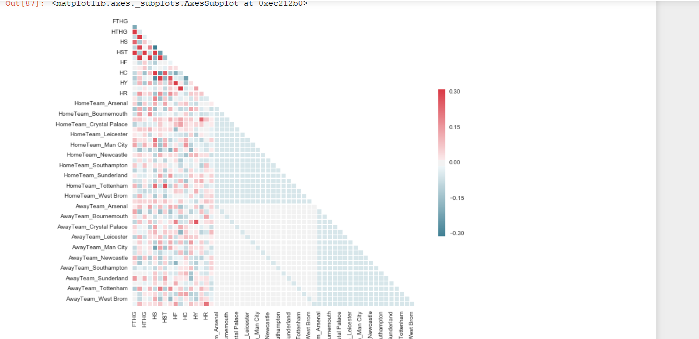
Visualization of Model and Model Outcome:

Slide 14
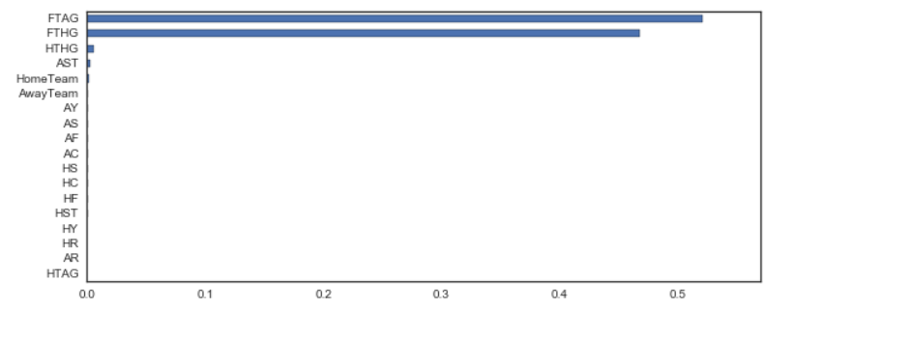
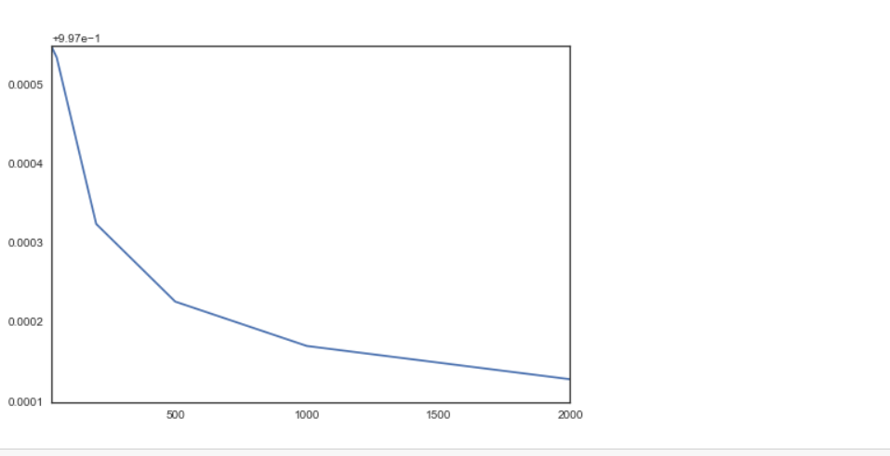
Visualization of features:
n_estimator:

Slide 15
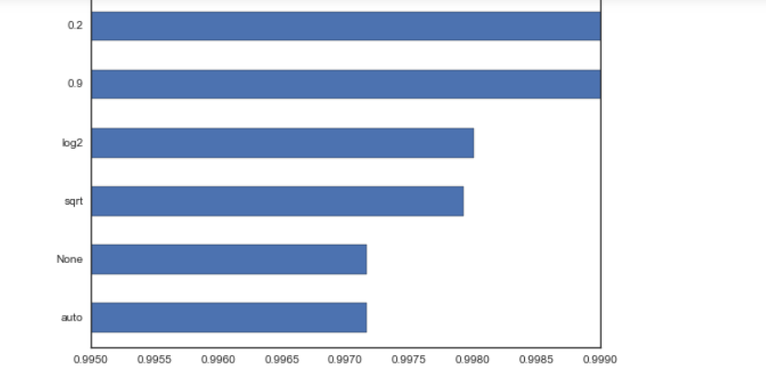
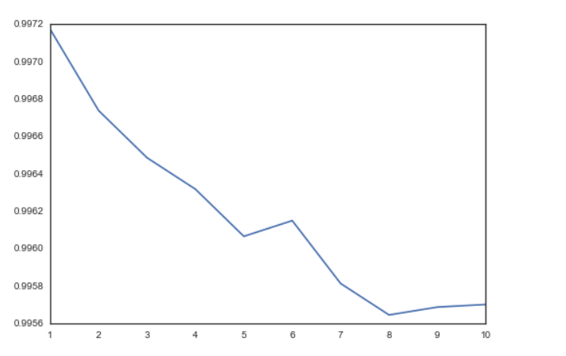
n_max and min samples

Slide 16
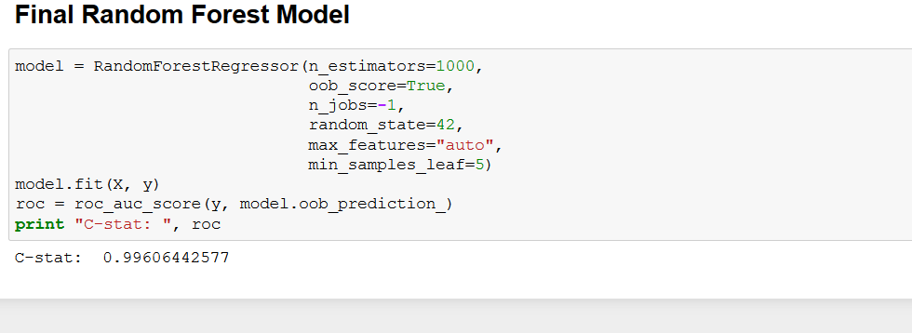
Final Random Regression:

Slide 17
Analysis of the Project:
Conclusion:
After the analysis of the model: As we used teams and data for the analysis and predict the result of the game we got the accuracy (AUC) score as 0.9961.
This is quite an impressive model as it nears to perfection
(i.e 1).
By using data science model we can better predict the outcome of a result.

